Slide 2
Enhancing Low-Resource Machine Translation via Interlinear Text Pre-training and Hybrid Random Embeddings
Presenter: David Pineda
Brigham Young University: Machine Translation Course

Slide 3
Motivation: Why Spanish-Kekchi?
Spanish
Kekchi
Low Resource
Data Scarcity
Kekchi is a low-resource indigenous language of Guatemala
Goal: Improve machine translation for the low – resource Spanish – Kekchi language pair by injecting linguistic structure *via glosses and improving rare word handling using hybrid embeddings
Notes:
Strategies to engance translation capabilites of LLMs for Machine translation
Focuses on augmenting LLMs cross lingual alignment abilites in pre training than larget bilingualdata sets
Naïve thought is more high quality data in SFT in LLMS yield limited results, not used properly??
Stage 3 in SFT yeilds significant enhancements of results when human annotators why is giving it instructions on source lanaguage effective

Slide 4
Our Approach
Spanish Sentence
Gloss (IBM Model 2 Alignment)
IGT Pretraining (Structured Input)
Hybrid Random Embedding
Fine-tune (mBART – 50)
Better Translation
Our Strategy: Linguistic Bias + Rare Word Handling
Notes:
Strategies to engance translation capabilites of LLMs for Machine translation
Focuses on augmenting LLMs cross lingual alignment abilites in pre training than larget bilingualdata sets
Naïve thought is more high quality data in SFT in LLMS yield limited results, not used properly??
Stage 3 in SFT yeilds significant enhancements of results when human annotators why is giving it instructions on source lanaguage effective

Slide 5
Related Work
Guo, J., Yang, H., Li, Z., Wei, D., Shang, H., & Chen, X. (2024). A Novel Paradigm Boosting Translation Capabilities of Large Language Models. Findings of the Association for Computational Linguistics: NAACL 2024, 639–649..
They show that continual pretraining on interlinear text improves multilingual LLMs like LLaMA2, even with less than 1 billion tokens.
Our connection: We adapt by providing interlinear text with structure as another parameter - pretraining strategy for smaller Transformer models in a custom Spanish–Kekchi MT setup, making it practical for very low-resource environments.
Tokarchuk, E., & Niculae, V. (2022). On target representation in continuous-output neural machine translation. Proceedings of the 7th Workshop on Representation Learning for NLP, 227–235.
Their study proposes transferring target embeddings from a pretrained discrete Transformer model into a continuous-output MT system, outperforming fastText and mBART embeddings. They show that embedding choice—particularly geometry and dimensionality—has a major impact on rare word translation in low-resource settings.
Our connection: Motivates the idea that embedding quality and geometry matter more than model size for low-resource MT. This hybrid random–pretrained embedding strategy builds on their findings by further exploring rare word robustness and embedding dispersion in a practical low-resource Transformer setup.
Notes:
(Interactive translation and instruction tuning): Instead of giving just one static translation, the model adapts based on user interaction, refining the output

Slide 6



Data and Tools
Dataset | # Sentences | Domain
Spanish–Kekchi | 164,903 | Religious (LDS)
Notes:
(Interactive translation and instruction tuning): Instead of giving just one static translation, the model adapts based on user interaction, refining the output

Slide 7
What Is a Gloss?
Gloss = word – level linguistic explanation
Spanish:
"Jesús dijo que el tabaco no es bueno para las personas"
Gloss:
"Jesús chi may us chi li"
Kekchi:
"Jesus kixye naq li may moko us ta choq qe"

Slide 8
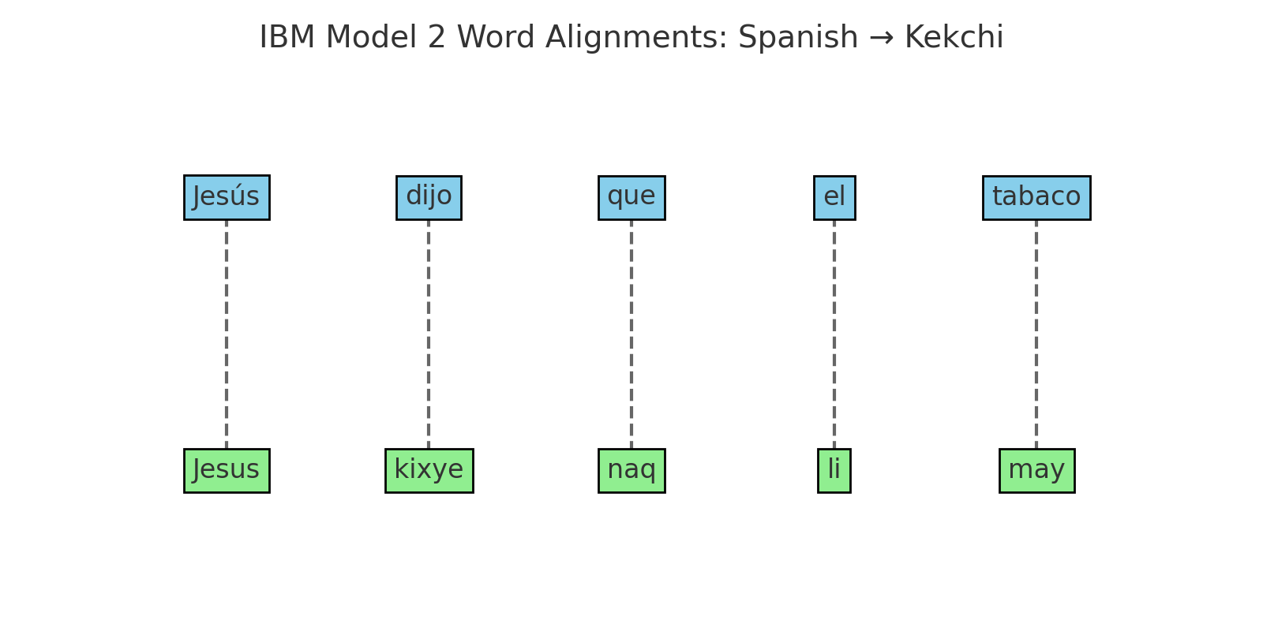
IBM Model 2: Word Alignment
Aligns Spanish and Kekchi at the word level
Produces (Spanish , Gloss, Kekchi) triples
Used to build structured input

Slide 9
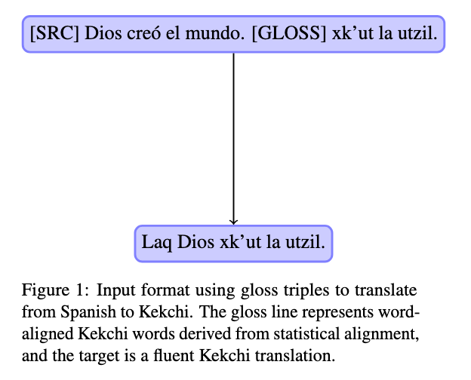
Building the IGT Triple
The [SRC] is in Spanish
The [Gloss] is the statistical alignment in Kekchi
The [Target] is Kekchi full sentence

Slide 10
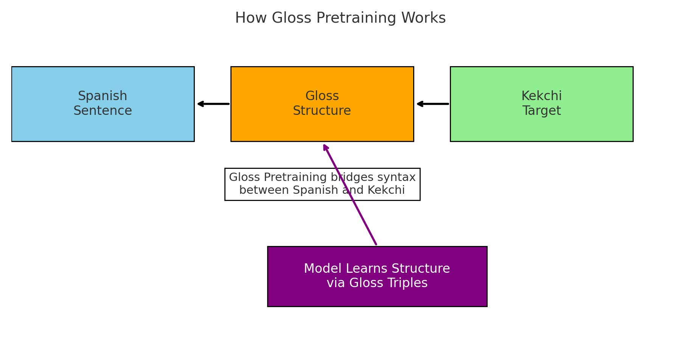
Why Gloss Pretraining Works
Injects grammar/morphology to help the model learn structure, which improves syntax and alignment

Slide 11
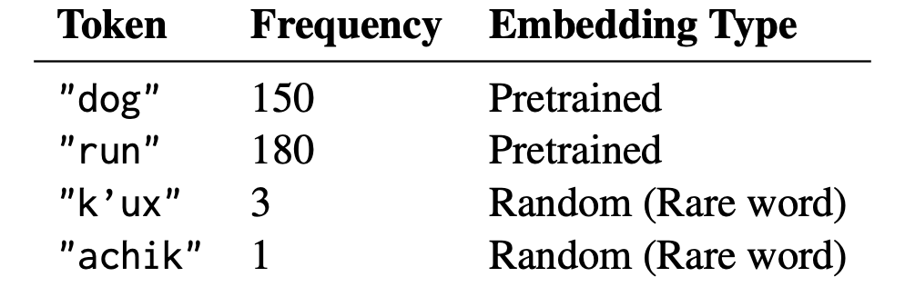
Hybrid Random Embedding Strategy
Frequent words = Pretrained Embeddings
Rare words = Random Embeddings
Mixed = Better generalization + rare word coverage
Notes:
(Interactive translation and instruction tuning): Instead of giving just one static translation, the model adapts based on user interaction, refining the output

Slide 12
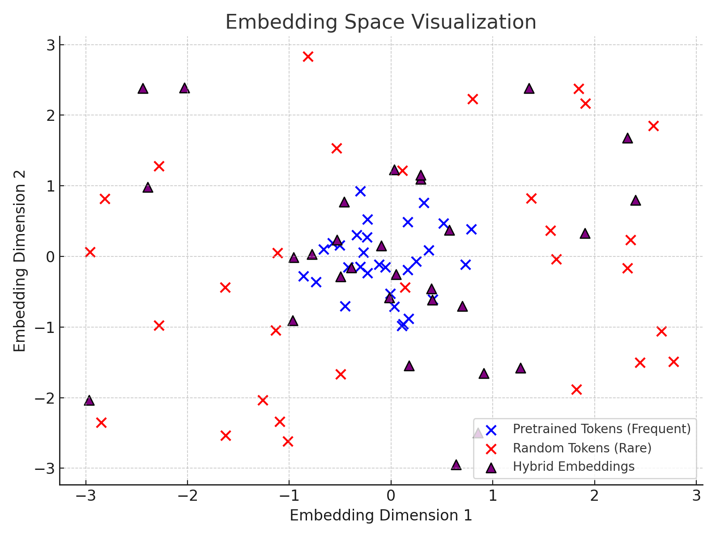
Visualizing Embedding Space
Pretrained tokens cluster (e.g "el", "hola"
Random tokens spread evenly
Hybrid = Blend

Slide 13
System Design
Baseline: Fine-tune mBART-50 directly on Spanish–Kekchi sentence pairs. (No structure, standard training.)
Gloss Pretraining: Pretrain model with Interlinear Glossed Text (IGT) triples to inject syntactic and morphological structure. (Better grammar and alignment understanding.)
Hybrid Random Embeddings: Initialize rare word embeddings randomly while keeping frequent word embeddings pretrained. (Boost rare word translation and overall stability.)
Baseline
+Gloss Pretraining
+Hybrid Random Embeddings
Evaluate Results
Notes:
(Interactive translation and instruction tuning): Instead of giving just one static translation, the model adapts based on user interaction, refining the output

Slide 14
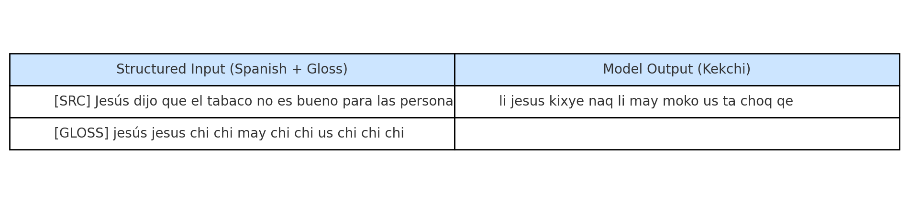
Real Translation Example
Training Example (Seen by Model)
Notes:
(Interactive translation and instruction tuning): Instead of giving just one static translation, the model adapts based on user interaction, refining the output

Slide 15
Real Translation Example
Field | Content | Notes
Input (Spanish) | Jesús dijo que el tabaco no es bueno para las personas
Gloss (Used in Training) | jesús jesus chi chi may chi chi us chi chi chi | → Guides structure understanding
Google Translate Output | Jesús dijo que la carne no es buena para nosotros | ❌ Incorrect — ‘carne’ ≠ ‘tabaco’
Our Model Output | li jesus kixye naq li may moko us ta choq qe | ✅ Correct — translation includes tabaco
Notes:
(Interactive translation and instruction tuning): Instead of giving just one static translation, the model adapts based on user interaction, refining the output

Slide 16
Experimental Setup
MBART-50 fine-tuning
Gloss pretraining
Hybrid embedding thresholds 0.9 and 0.7
Metrics: BLEU (Bilingual Evaluation Understudy), ChrF++, ROUGE-L, COMET
Notes:
(Interactive translation and instruction tuning): Instead of giving just one static translation, the model adapts based on user interaction, refining the output

Slide 17
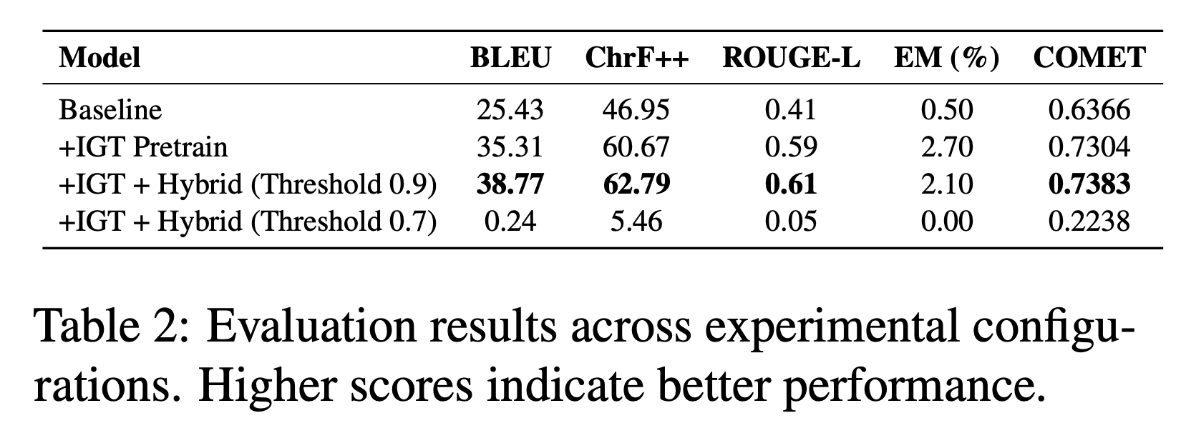
Results
Notes:
(Interactive translation and instruction tuning): Instead of giving just one static translation, the model adapts based on user interaction, refining the output

Slide 18
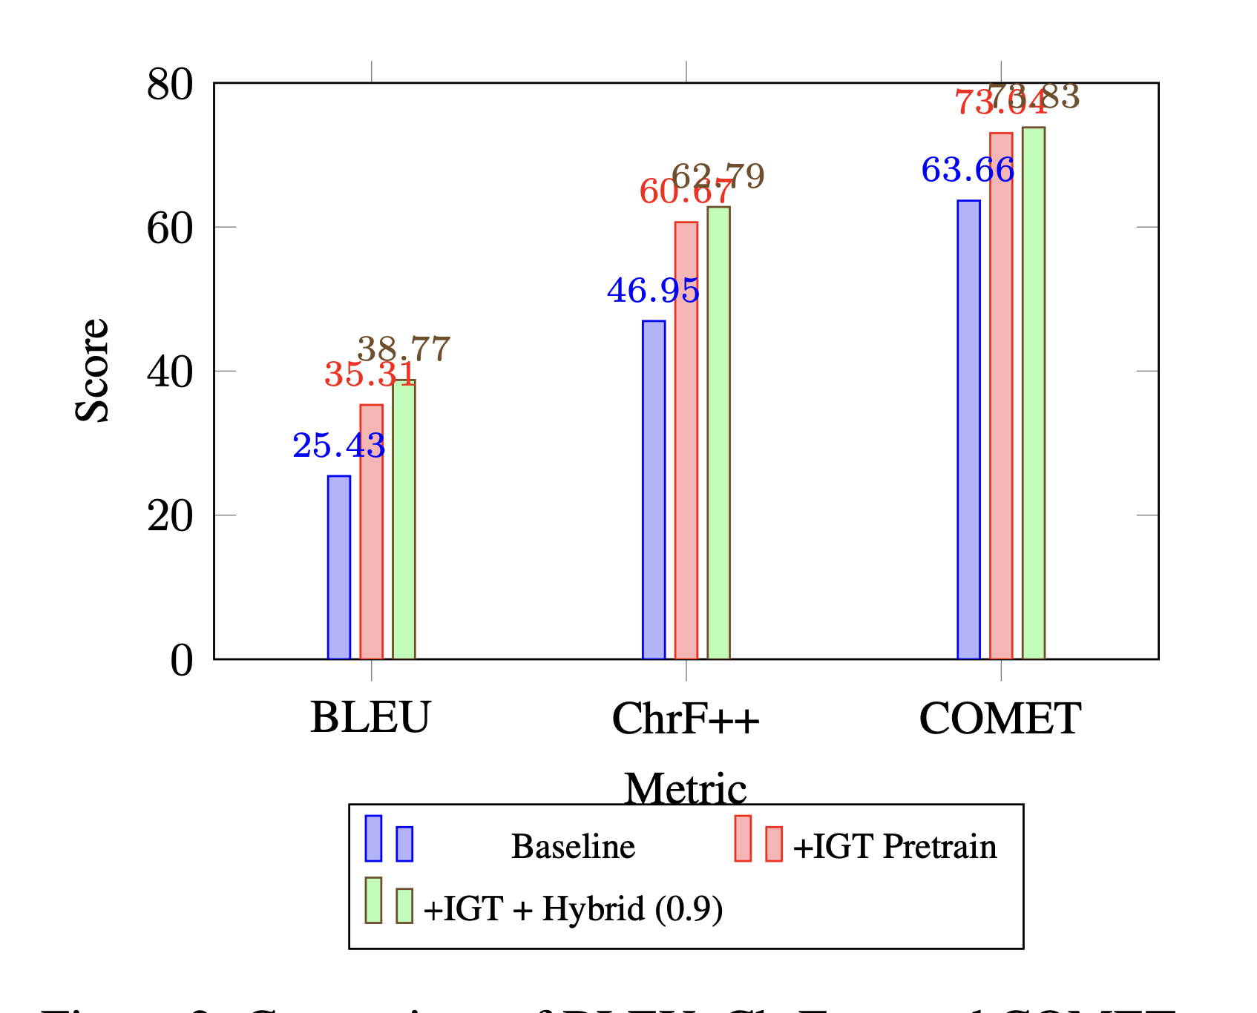
Metric Improvements
Notice Consistent Improvements across metrics
Notes:
(Interactive translation and instruction tuning): Instead of giving just one static translation, the model adapts based on user interaction, refining the output

Slide 19
Interpretation
Gloss Pretraining | Hybrid Embedding
+ 10 BLEU points Better grammar/syntax modeling | Fixes rare word translation
Notes:
(Interactive translation and instruction tuning): Instead of giving just one static translation, the model adapts based on user interaction, refining the output

Slide 20
Limitations
Domain – specific dataset (religious text only)
Dataset size still small (~165k sentences)
Hybrid embedding threshold is sensitive
Notes:
(Interactive translation and instruction tuning): Instead of giving just one static translation, the model adapts based on user interaction, refining the output

Slide 21
Future Directions
Try conversational/technical domain
Expand hybrid method tuning
Use other models to train on
Notes:
(Interactive translation and instruction tuning): Instead of giving just one static translation, the model adapts based on user interaction, refining the output

Slide 22
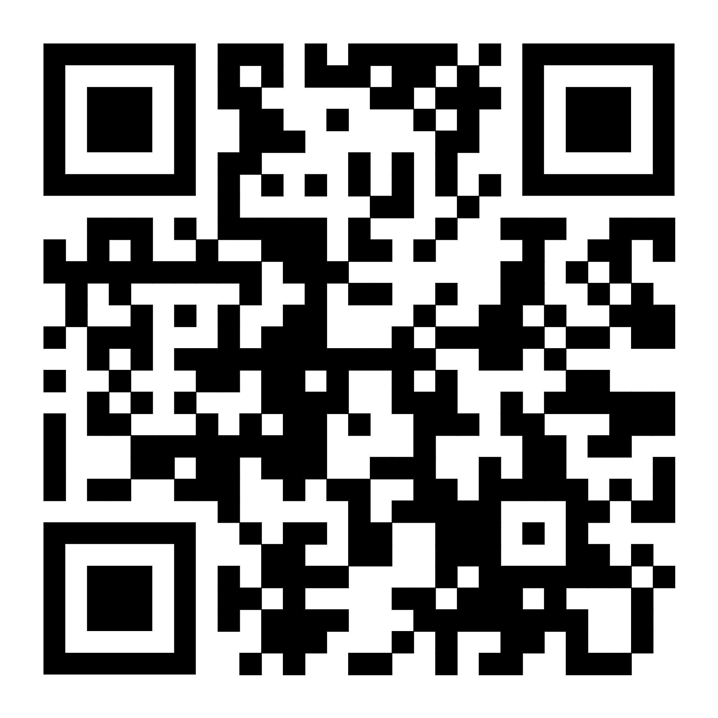

Thank You!
Notes:
(Interactive translation and instruction tuning): Instead of giving just one static translation, the model adapts based on user interaction, refining the output

Slide 24
Questions
What are potential challenges in using a hybrid random embeddings in larger vocabulary sizes datasets?
How to extend this approach to further improve rare word translation without having to rely on random embeddings?
Notes:
(Interactive translation and instruction tuning): Instead of giving just one static translation, the model adapts based on user interaction, refining the output

